Slide 1
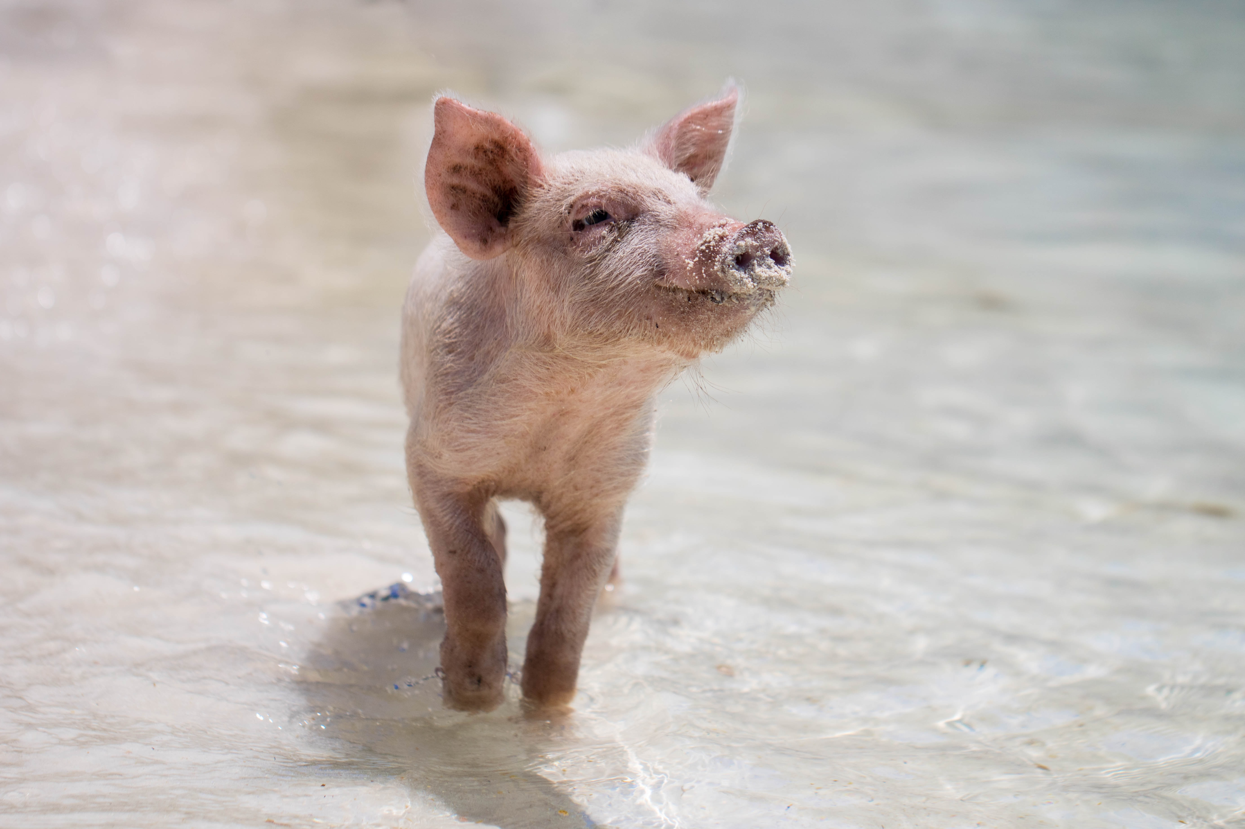
THE TALENTED PIG

Slide 2
How it works
1. Pick a slide
2. Check the notes
3. Copy & Share
Decide what problem you’d like your team to focus on. Then pick a slide that addresses it.
Planning
Moving Faster
Problem Solving
Check your notes sections for suggestions on how to open your meeting.
Copy the slide and paste it into your deck.
You may share this guide with others, print, and email copies,.
You can’t alter this guide or charge for it.

Slide 3
Never try to teach a pig to sing. It wastes your time and annoys the pig.
Notes:
Problem: We all like different things. That’s what makes us interesting. We’re happier and more productive doing things we like.
The problem comes when we’re asked to do things we don’t like. Sometimes, we have no choice. Other times, we do.

Slide 4
​What parts of your job do you love to do? What would you prefer to offload?
Notes:
Solution: ​What parts of your job do you love to do? What would you prefer to offload?

Slide 5
Never try to teach a pig to sing. It wastes your time and annoys the pig.
​What parts of your job do you love to do? What would you prefer to offload?
Notes:
Problem: We all like different things. That’s what makes us interesting. We’re happier and more productive doing things we like.
The problem comes when we’re asked to do things we don’t like. Sometimes, we have no choice. Other times, we do.
Solution: ​What parts of your job do you love to do? What would you prefer to offload?

Slide 6
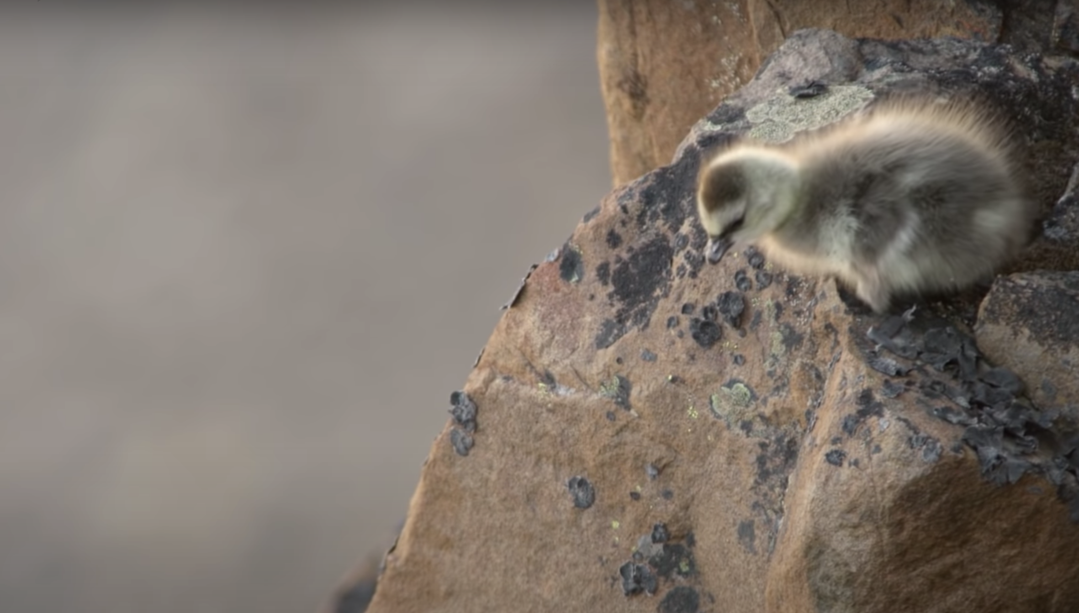
What can we learn from baby branta geese?
A baby barnacle geese hatches in a nest 40 stories high without the ability to fly.
She has to take a leap of faith and fall all the way down a cliff in order to get food or starve. A miracle happens. Her soft feathers cushion the fall. She finds her parents and eats.
Luckily, we don’t have to leap as far. Brantio is named after the baby Branta geese. Fear steals dreams. What would we do if we weren’t afraid?
Taking the leap is hard. But worth it.
I’m hoping you’ll take the leap, with us, or with someone else. The world needs your brilliant ideas.
- Anwell. Tsai
CEO and founder of Brantio
Contact us. We’d love to hear from you.
www.brantio.com

