Slide 1
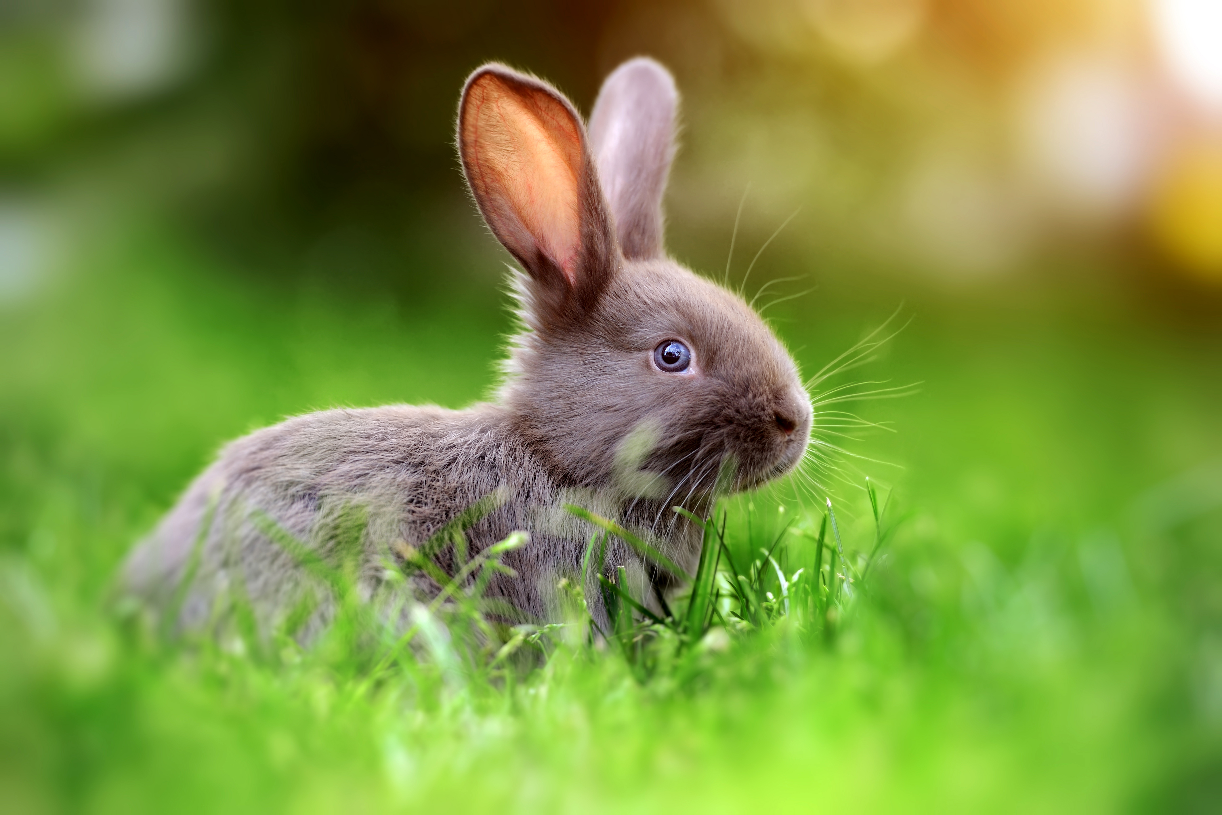
A Clever Rabbit

Slide 2
How it works
1. Choose
2. Check the notes
3. Copy & Share
Build tension and release by showing a series of slides.
Use just the explainer slide at the end.
Check your notes sections for tips on how to start your meeting with a bang.
Copy the slide and paste it into your deck.
You may share this guide with others, print, and email copies,.
You can’t alter this guide or charge for it.

Slide 3
A clever rabbit has 3 holes.
Notes:
Problem: We often fall in love with the first viable option. This makes sense. We want to support each other’s ideas. The problem is, group consensus often leads to the safe choice. This potentially leaves better solutions off the table. This is because generating bold new ideas uses a different part of the brain from assessing risk and narrowing ideas down.

Slide 4
What alternative choices might we consider?
Notes:
Solution: Let’s encourage each of us to be open and give non-traditional and risky options. Let’s unearth as many options as possible. We’ll hold off on any commentary or analysis. Only after we’ve scraped the bottom of the barrow, let’s narrow down to 3 possibilities. What alternative choices might we consider?

Slide 5
A clever rabbit has 3 holes.
What alternative choices might we consider?
Notes:
Problem: We often fall in love with the first viable option. This makes sense. We want to support each other’s ideas. The problem is, group consensus often leads to the safe choice. This potentially leaves better solutions off the table. This is because generating bold new ideas uses a different part of the brain from assessing risk and narrowing ideas down.
Solution: Let’s encourage each of us to be open and give non-traditional and risky options. Let’s unearth as many options as possible. We’ll hold off on any commentary or analysis. Only after we’ve scraped the bottom of the barrow, let’s narrow down to 3 possibilities. What alternative choices might we consider?

Slide 6
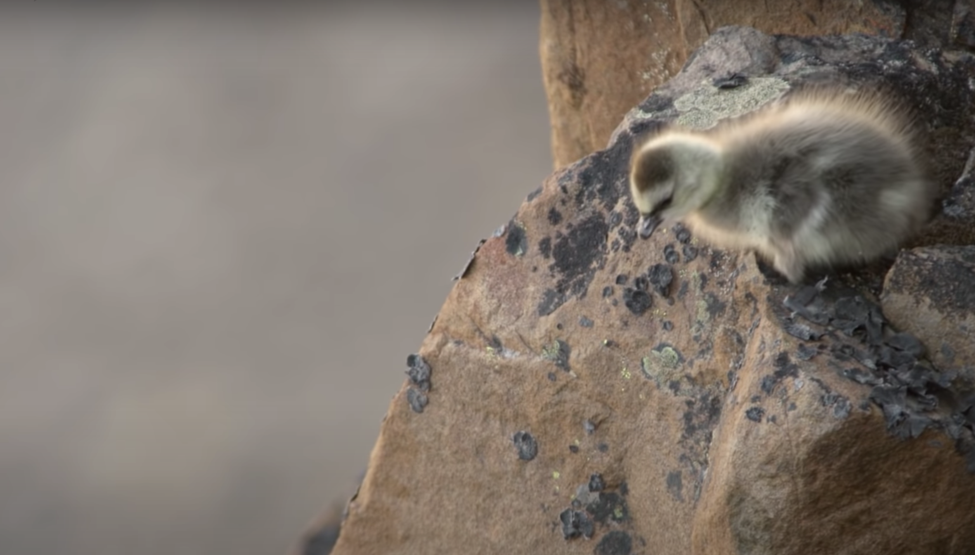
What can we learn from baby branta geese?
A baby barnacle geese hatches in a nest 40 stories high without the ability to fly.
She has to take a leap of faith and fall all the way down a cliff in order to get food or starve. A miracle happens. Her soft feathers cushion the fall. She finds her parents and eats.
Luckily, we don’t have to leap as far. Brantio is named after the baby Branta geese. Fear steals dreams. What would we do if we weren’t afraid?
Taking the leap is hard. But worth it.
I’m hoping you’ll take the leap, with us, or with someone else. The world needs your brilliant ideas.
- Anwell. Tsai
CEO and founder of Brantio
Contact us. We’d love to hear from you.
www.brantio.com

