Slide 1
THE MOST EXPENSIVE GIFT

Slide 2
How it works
1. Choose
2. Check the notes
3. Copy & Share
Build tension and release by showing a series of slides.
Use just the explainer slide at the end.
Check your notes sections for tips on how to start your meeting with a bang.
Copy the slide and paste it into your deck.
You may share this guide with others, print, and email copies,.
You can’t alter this guide or charge for it.

Slide 3
​“Honesty is a very expensive gift. Don’t expect it from cheap people.” - Warren Buffett
Notes:
Problem: Every place we’ved worked talks about how we should be honest with each other. But how many times have we felt comfortable enough to give our honest opinion to a coworker? A manager? Even friends and family? It’s understandable that people steer away from giving their honest views. We don’t want to hurt people’s feelings. We may not be confident in our views. We want our peers to feel confident.
However, many problems could have been avoided if people felt comfortable enough to share what they really thought.

Slide 4
​How might we create an environment where we’re open and honest, especially when it’s tough? What might we gain?
Notes:
Solution: ​How might we create an environment where we’re open and honest, especially when it’s tough? What might we gain?

Slide 5
​“Honesty is a very expensive gift. Don’t expect it from cheap people.” - Warren Buffett
​How might we create an environment where we’re open and honest, especially when it’s tough?
What might we gain?
Notes:
Problem: Every place we’ved worked talks about how we should be honest with each other. But how many times have we felt comfortable enough to give our honest opinion to a coworker? A manager? Even friends and family? It’s understandable that people steer away from giving their honest views. We don’t want to hurt people’s feelings. We may not be confident in our views. We want our peers to feel confident.
However, many problems could have been avoided if people felt comfortable enough to share what they really thought.
Solution: ​How might we create an environment where we’re open and honest, especially when it’s tough? What might we gain?

Slide 6
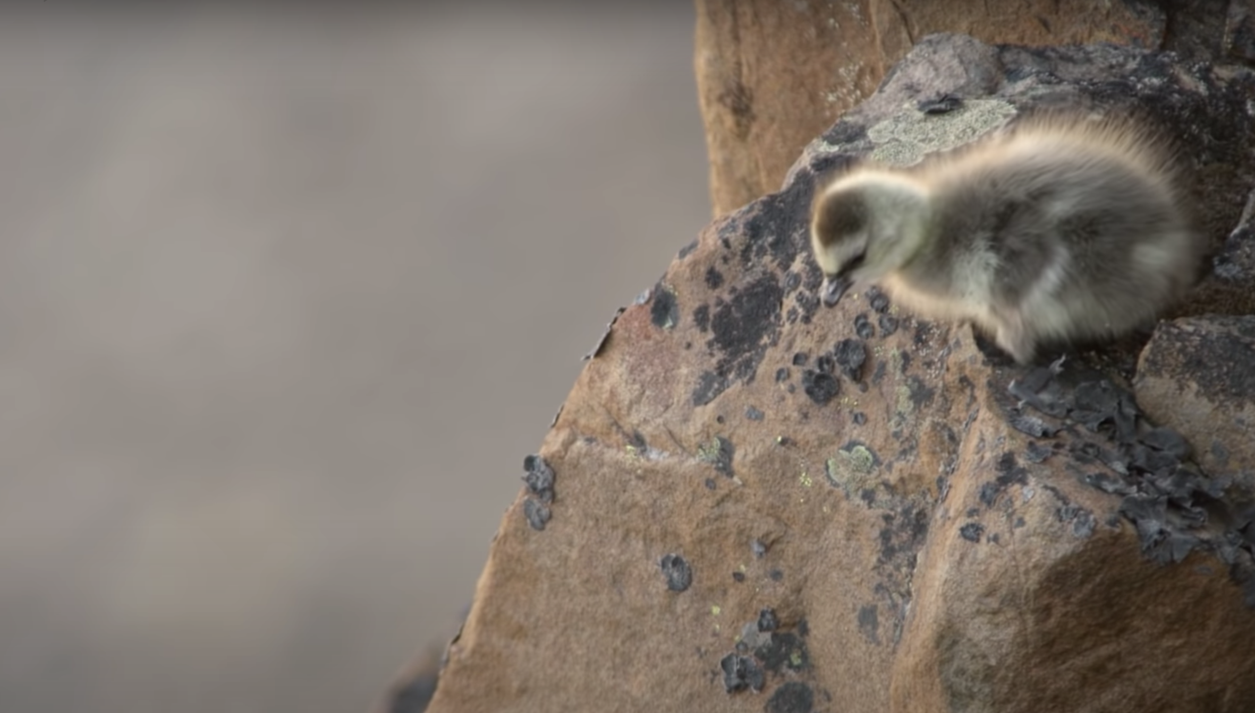
What can we learn from baby branta geese?
A baby barnacle geese hatches in a nest 40 stories high without the ability to fly.
She has to take a leap of faith and fall all the way down a cliff in order to get food or starve. A miracle happens. Her soft feathers cushion the fall. She finds her parents and eats.
Luckily, we don’t have to leap as far. Brantio is named after the baby Branta geese. Fear steals dreams. What would we do if we weren’t afraid?
Taking the leap is hard. But worth it.
I’m hoping you’ll take the leap, with us, or with someone else. The world needs your brilliant ideas.
- Anwell. Tsai
CEO and founder of Brantio
Contact us. We’d love to hear from you.
www.brantio.com

