Slide 1
HARDEST PROBLEMS

Slide 2
How it works
1. Choose
2. Check the notes
3. Copy & Share
Build tension and release by showing a series of slides.
Use just the explainer slide at the end.
Check your notes sections for tips on how to start your meeting with a bang.
Copy the slide and paste it into your deck.
You may share this guide with others, print, and email copies,.
You can’t alter this guide or charge for it.

Slide 3
​"If I had an hour to solve a problem, I'd spend 55 minutes thinking about the problem and 5 minutes thinking about solutions."
- Einstein
Problem: 1 min
Solution: 1 min
Notes:
Problem: Sometimes, we jump into possible solutions, without considering what the real problem is. If we aren’t crystal clear on what the real problem is, our solutions will fail.

Slide 4
How might we make sure we’re addressing the real problem?
Problem: 1 min
Solution: 1 min
Notes:
Solution: How might we make sure we’re addressing the real problem?

Slide 5
​"If I had an hour to solve a problem, I'd spend 55 minutes thinking about the problem and 5 minutes thinking about solutions."
Einstein
How might we make sure we’re addressing the real problem?
Problem: 1 min
Solution: 1 min
Notes:
Problem: Sometimes, we jump into possible solutions, without considering what the real problem is. If we aren’t crystal clear on what the real problem is, our solutions will fail.
Solution: How might we make sure we’re addressing the real problem?

Slide 6
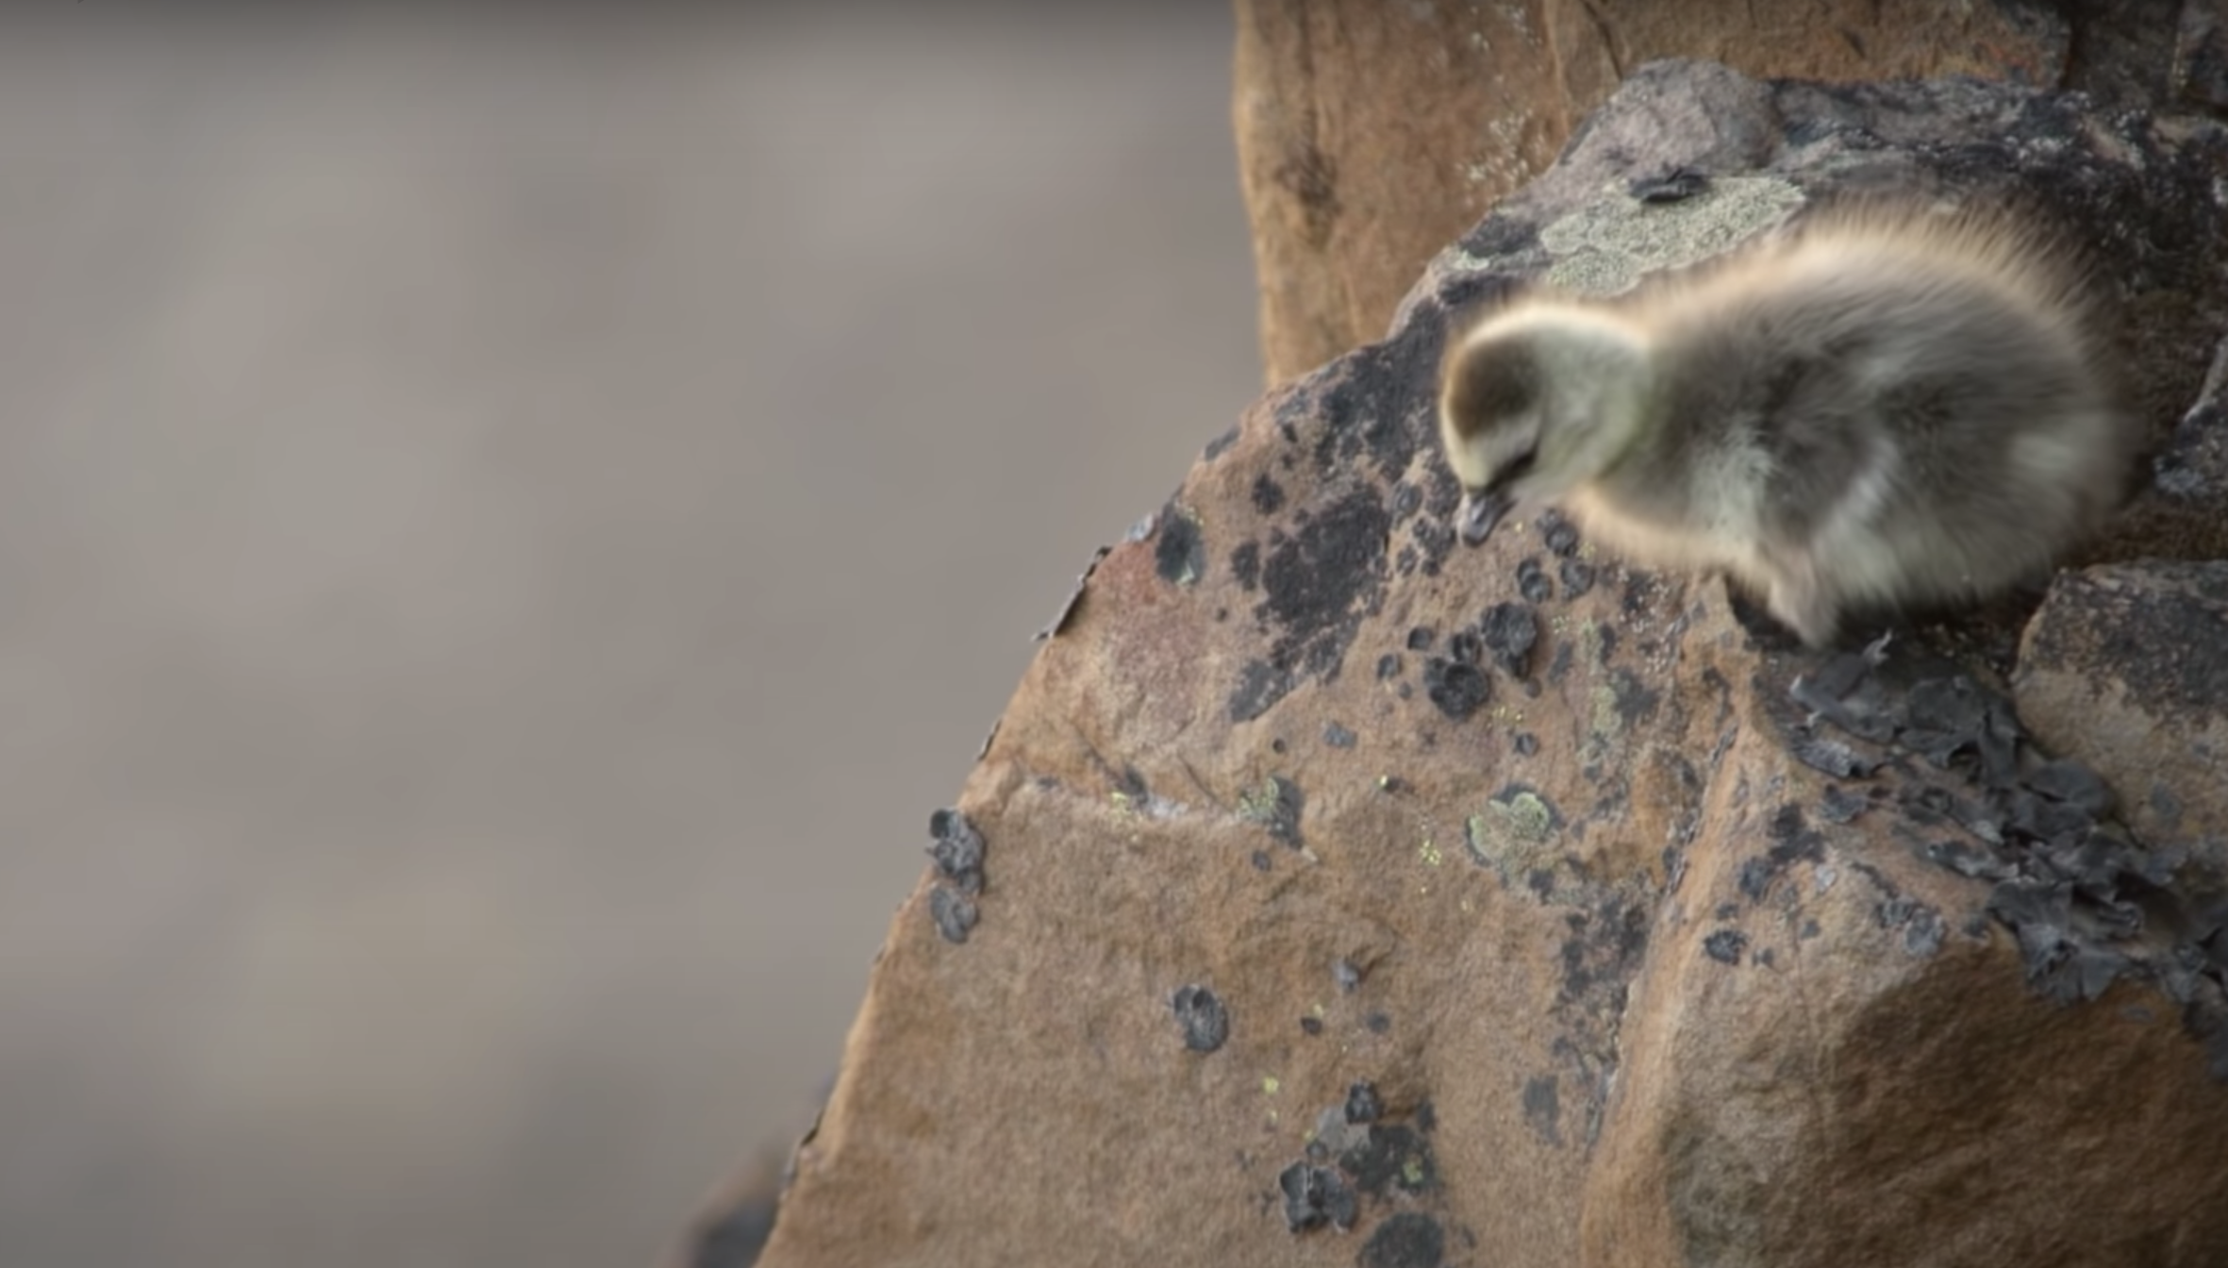
What can we learn from baby branta geese?
A baby barnacle geese hatches in a nest 40 stories high without the ability to fly.
She has to take a leap of faith and fall all the way down a cliff in order to get food or starve. A miracle happens. Her soft feathers cushion the fall. She finds her parents and eats.
Luckily, we don’t have to leap as far. Brantio is named after the baby Branta geese. Fear steals dreams. What would we do if we weren’t afraid?
Taking the leap is hard. But worth it.
I’m hoping you’ll take the leap, with us, or with someone else. The world needs your brilliant ideas.
- Anwell. Tsai
CEO and founder of Brantio
Contact us. We’d love to hear from you.
www.brantio.com

