Slide 1
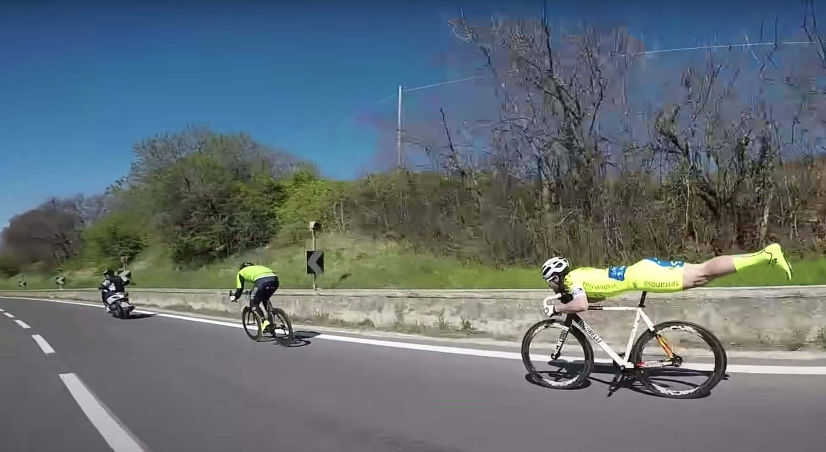
Who will win?
​
Notes:
Problem: The racer in the superman pose, Michael Guerra, was in last place. Michael tried pushing himself harder. Pedaling faster. Nothing worked. Then, he decided to stop pedaling to go into his superman pose. He started gaining on each biker, until he was alone in first place. Even better, he pulled ahead of that motorcycle!
Michael realized that the limiting factor in cycling downhill isn’t foot power. It’s the drag the body creates. By streamlining his body, like a whale, and limiting drag, his bike took off!
Everyone here is smart. Everyone is hardworking. But some people get more done than others. How? By working smarter, not harder. It’s easy to say, but hard to do.
You can watch and share the video here: https://www.youtube.com/watch?v=3Iz7ZMALaCY
Solution: How might we work smarter, not harder?

Slide 2
How it works
1. Choose
2. Check the notes
3. Copy & Share
Build tension and release by showing a series of slides.
Use just the explainer slide at the end.
Check your notes sections for tips on how to start your meeting with a bang.
Copy the slide and paste it into your deck.
You may share this guide with others, print, and email copies,.
You can’t alter this guide or charge for it.

Slide 3
Who will win? Why?
​
Notes:
Problem: The racer in the superman pose, Michael Guerra, was in last place. Michael tried pushing himself harder. Pedaling faster. Nothing worked. Then, he decided to stop pedaling to go into his superman pose. He started gaining on each biker, until he was alone in first place. Even better, he pulled ahead of that motorcycle!
Michael realized that the limiting factor in cycling downhill isn’t foot power. It’s the drag the body creates. By streamlining his body, like a whale, and limiting drag, his bike took off!
Everyone here is smart. Everyone is hardworking. But some people get more done than others. How? By working smarter, not harder. It’s easy to say, but hard to do.
You can watch and share the video here: https://www.youtube.com/watch?v=3Iz7ZMALaCY

Slide 4
How might we work smarter, not harder?
​
Notes:
Solution: How might we work smarter, not harder?

Slide 5
Who will win?
​
Notes:
Problem: The racer in the superman pose, Michael Guerra, was in last place. Michael tried pushing himself harder. Pedaling faster. Nothing worked. Then, he decided to stop pedaling to go into his superman pose. He started gaining on each biker, until he was alone in first place. Even better, he pulled ahead of that motorcycle!
Michael realized that the limiting factor in cycling downhill isn’t foot power. It’s the drag the body creates. By streamlining his body, like a whale, and limiting drag, his bike took off!
Everyone here is smart. Everyone is hardworking. But some people get more done than others. How? By working smarter, not harder. It’s easy to say, but hard to do.
You can watch and share the video here: https://www.youtube.com/watch?v=3Iz7ZMALaCY
Solution: How might we work smarter, not harder?

Slide 6
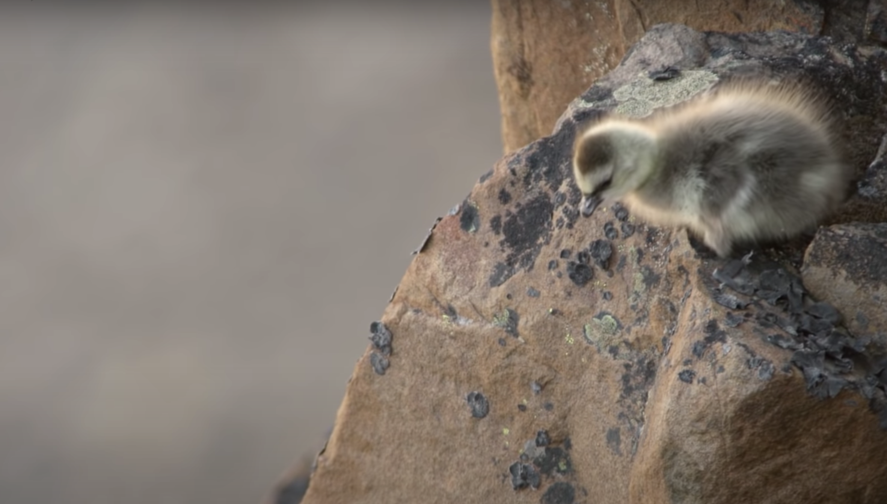
What can we learn from baby branta geese?
A baby barnacle geese hatches in a nest 40 stories high without the ability to fly.
She has to take a leap of faith and fall all the way down a cliff in order to get food or starve. A miracle happens. Her soft feathers cushion the fall. She finds her parents and eats.
Luckily, we don’t have to leap as far. Brantio is named after the baby Branta geese. Fear steals dreams. What would we do if we weren’t afraid?
Taking the leap is hard. But worth it.
I’m hoping you’ll take the leap, with us, or with someone else. The world needs your brilliant ideas.
- Anwell. Tsai
CEO and founder of Brantio
Contact us. We’d love to hear from you.
www.brantio.com

