Slide 1
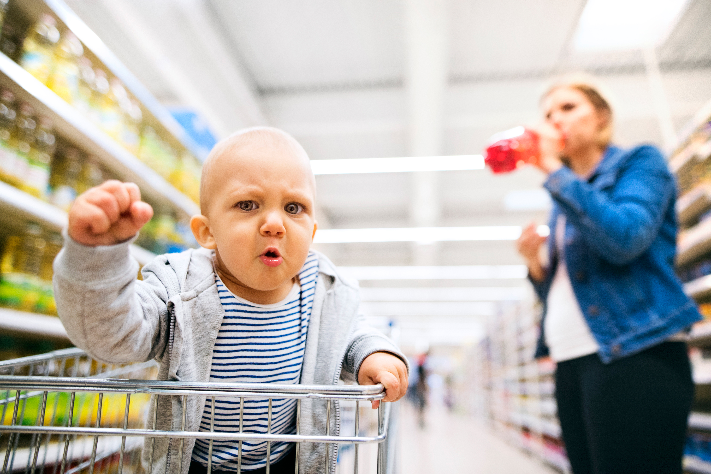
NO, NO, NO!

Slide 2
How it works
1. Choose
2. Check the notes
3. Copy & Share
Build tension and release by showing a series of slides.
Use just the explainer slide at the end.
Check your notes sections for tips on how to start your meeting with a bang.
Copy the slide and paste it into your deck.
You may share this guide with others, print, and email copies,.
You can’t alter this guide or charge for it.

Slide 3
What might kids teach us?
________________________________
Notes:
Problem: Once kids turn 2, they learn the most powerful word. No. They use it relentlessly.
As adults, we learn how to be more accommodating. This is a good thing. The problem happens when we get flooded with requests. It’s hard to say no. So we end up burning the midnight oil getting things done for others while neglecting our own priorities.

Slide 4
“You’ve gotta keep control of your time, and you can’t unless you say no.
You can’t let people set your agenda in life.”
- Warren Buffet

Slide 5
To help us say no to people, what priorities should we
say yes to?
Notes:
Solution: Instead of trying to say no to people, how might we say yes to our own priorities?

Slide 6
What might kids teach us?
________________________________
To help us say no to people, what priorities should we say yes to?
Notes:
Problem: Once kids turn 2, they learn the most powerful word. No. They use it relentlessly.
As adults, we learn how to be more accommodating. This is a good thing. The problem happens when we get flooded with requests. It’s hard to say no. So we end up burning the midnight oil getting things done for others while neglecting our own priorities.
Solution: Instead of trying to say no to people, how might we say yes to our own priorities?
“You’ve gotta keep control of your time, and you can’t unless you say no. You can’t let people set your agenda in life.” - Warren Buffet

Slide 7
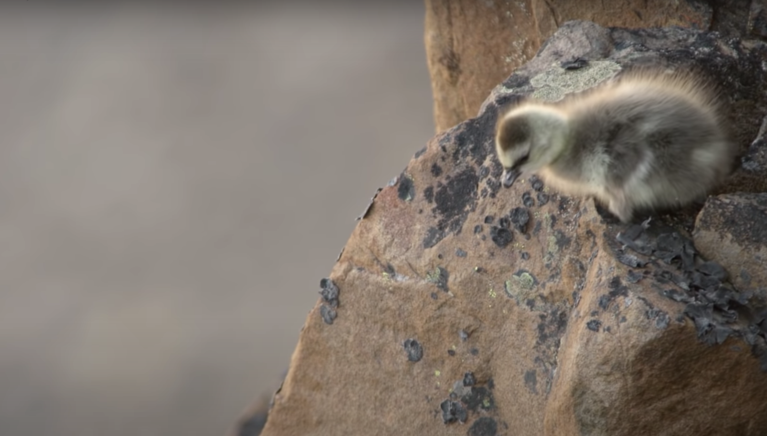
What can we learn from baby branta geese?
A baby barnacle geese hatches in a nest 40 stories high without the ability to fly.
She has to take a leap of faith and fall all the way down a cliff in order to get food or starve. A miracle happens. Her soft feathers cushion the fall. She finds her parents and eats.
Luckily, we don’t have to leap as far. Brantio is named after the baby Branta geese. Fear steals dreams. What would we do if we weren’t afraid?
Taking the leap is hard. But worth it.
I’m hoping you’ll take the leap, with us, or with someone else. The world needs your brilliant ideas.
- Anwell. Tsai
CEO and founder of Brantio
Contact us. We’d love to hear from you.
www.brantio.com

